Slide 1


Slide 2

GoGreen
“IF THERE IS ANYTHING THAT CAN SAVE OUR EARTH,
THEY ARE TREES!”

Slide 3
Team gogreen
Name of team :- Team GoGreen
Members :-
Suryaprakash Agarwal
Anmol Mittal
Keshav Sarraf
Dhruv Golani
College :-
Malaviya National Institute of technology

Slide 4
Problem ?
Our Mother Earth is currently facing lot of environmental concerns. The environmental problems like global warming, acid rain, air pollution, urban sprawl, waste disposal, ozone layer depletion, water pollution, climate change and many more affect every human, animal and nation on this planet. Over the last few decades, the exploitation of our planet and degradation of our environment have gone up at an alarming rate. As our actions have been not in favor of protecting this planet, we have seen natural disasters striking us more often in the form of flash floods, tsunamis and cyclones.
Environment has become our second priority and it is high time we realize the urgency to act upon our environment to save it.

Slide 5
solution ?
GoGreen smart web-application powered by Recycli android app
A website cum android app powered by Artificial Intelligence(AI) and Machine learning(ML) with mission to restore our beautiful green environment. It consists of two way login- one for users and the other for Administration.
User Portal will include following key features:-
A complete information portal of all the environmental events happening around.
Integrated chatbot for instantly addressing any of your queries.
Host your own creative events and also get funded by our community.
Real time environment related News feed updating.
Report local environmental concerns to public officials, allows other users to upvote concern, comment their views and provides a public interference to show if any action has been taken.
Get real time updates about various parameters of air we are breathing in.(AQI, PM10, Ozone, Carbon-monoxide, Sulphur dioxide etc).
Various fascinating challenges to increase active participation of people.
Earn GoGreen credits on completing challenges, solving issues, hosting and attending events and contributing in any possible ways.

Slide 6
solution ?
GoGreen smart web-application powered by Recycli android app
User Portal continues…
Maintain streak of our activities, viz. tree plantation, cleaning campaign etc. And share this with people in your network to grow collaboratively and promote healthy competition.
Build and enhance your network with nearby people, communities, local authority having same interest.
Build your green profile.
Locate best green nearby location healthy for any activities.
GoGreen box to donate any amount to contribute in saving the environment. Users can request fund for relevant events also.
With integrated web view, user can find information about environment, climate, pollution and other parameters of any location on earth.
Environmentopedia gives every information we need to know about our environment.

Slide 7
solution ?
GoGreen smart web-application powered by Recycli android app
Admin Portal will include following key features:-
Keep track of every user activity on GoGreen.
Approve or decline user request on hosting events, publishing issues on the portal.
Grant or reject fund requests.
Post exciting challenges on regular basis to keep everyone active and involved.

Slide 8
solution ?
GoGreen smart web-application powered by Recycli android app
Recycli App will include following key features:-
Classification of waste into ORGANIC and RECYCLABLE with powerful ML library KERAS.
Get material composition of object around us.
Capturing image in our phone will provide the best possible ways to manage waste.
Can be used by local authorities and local public to prevent careless handling of waste.
User friendly interface and instant response.

Slide 9
Preview -
GOGREEN
(please play the video in next slide)

Slide 10


Slide 11
Demonstration
Of
GOGREEN

Slide 12
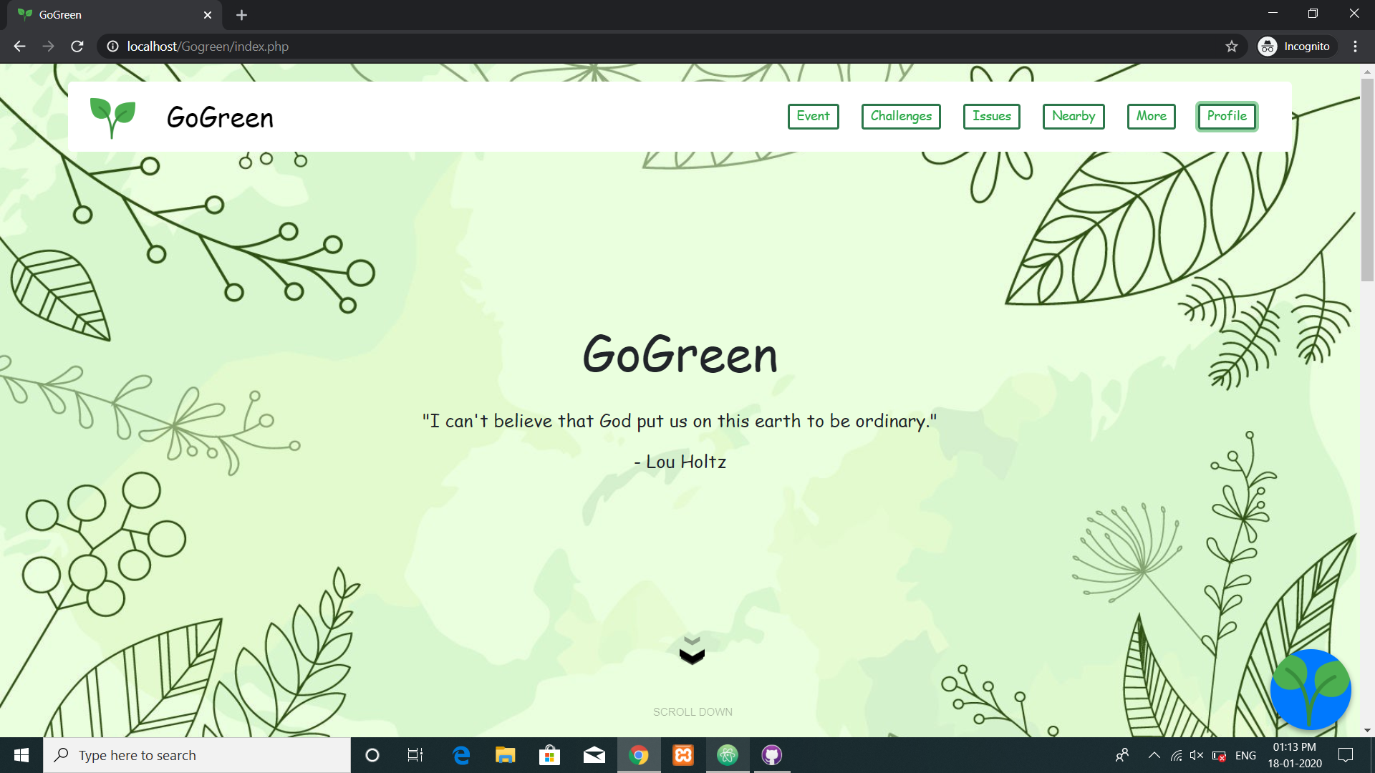
HOMEPAGE

Slide 13
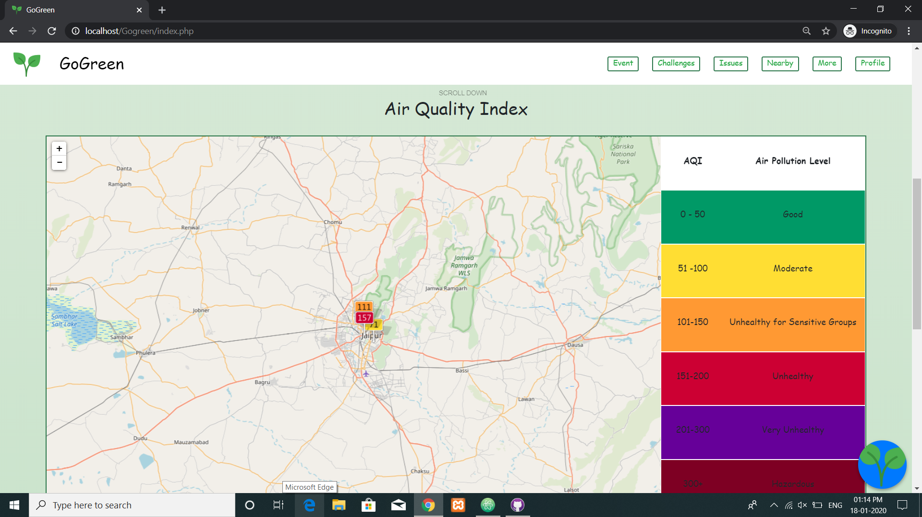
API FETCHING DATA

Slide 14
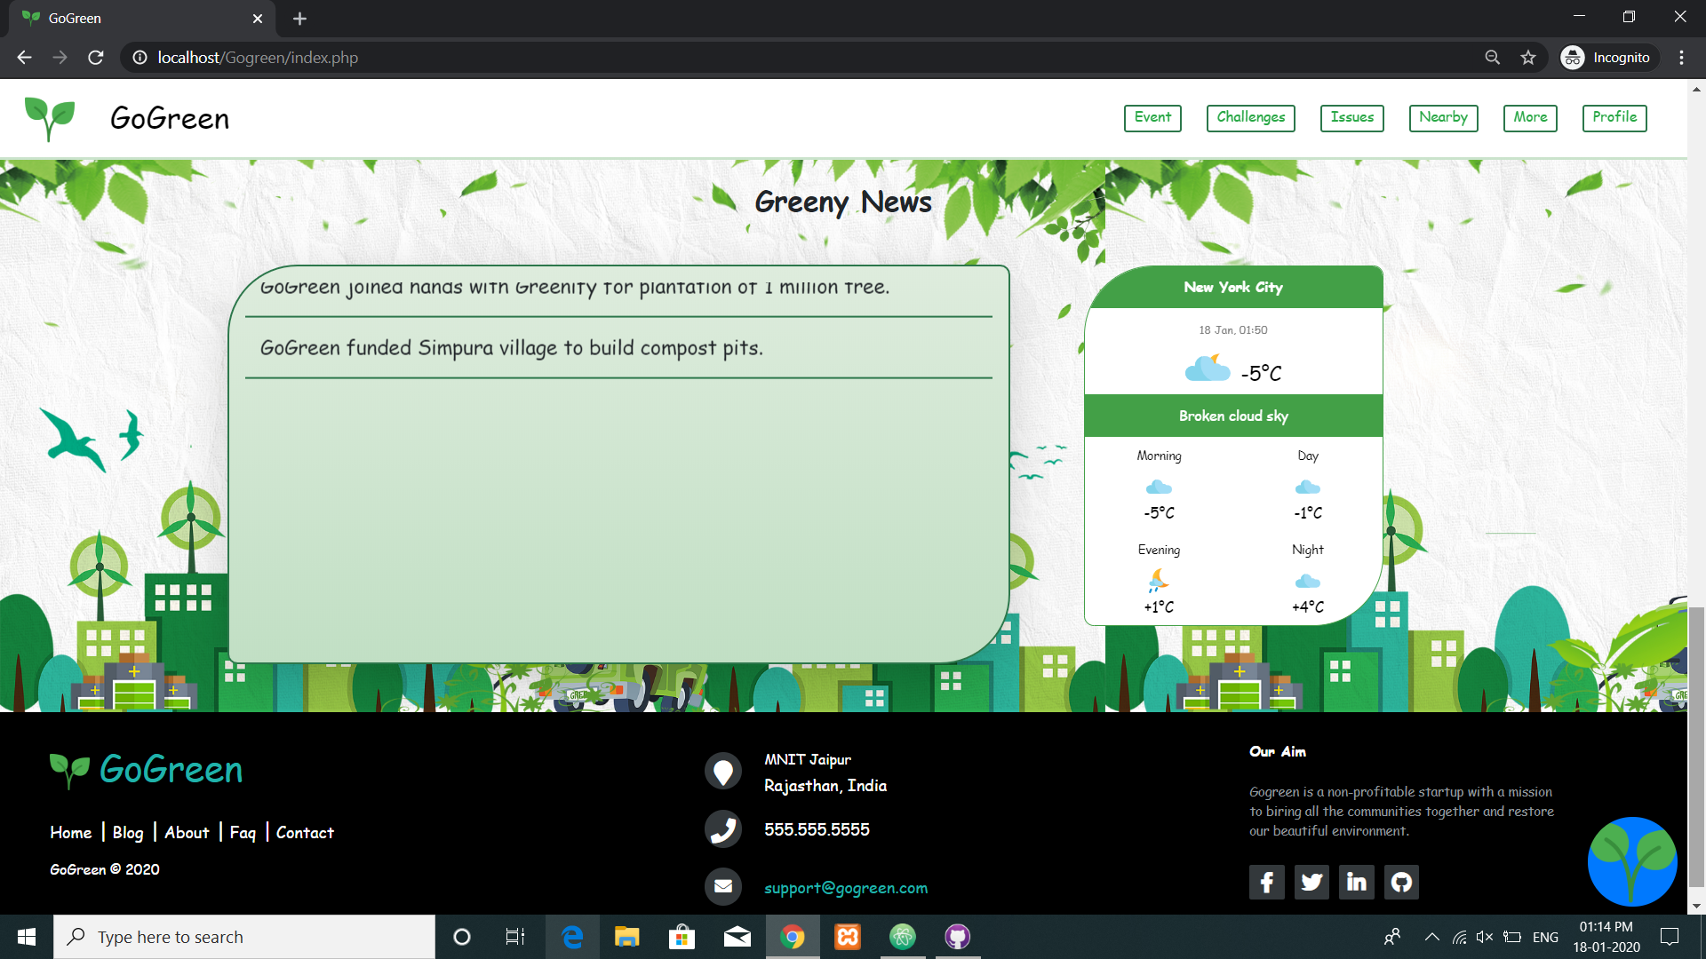
GREEN NEWS

Slide 15
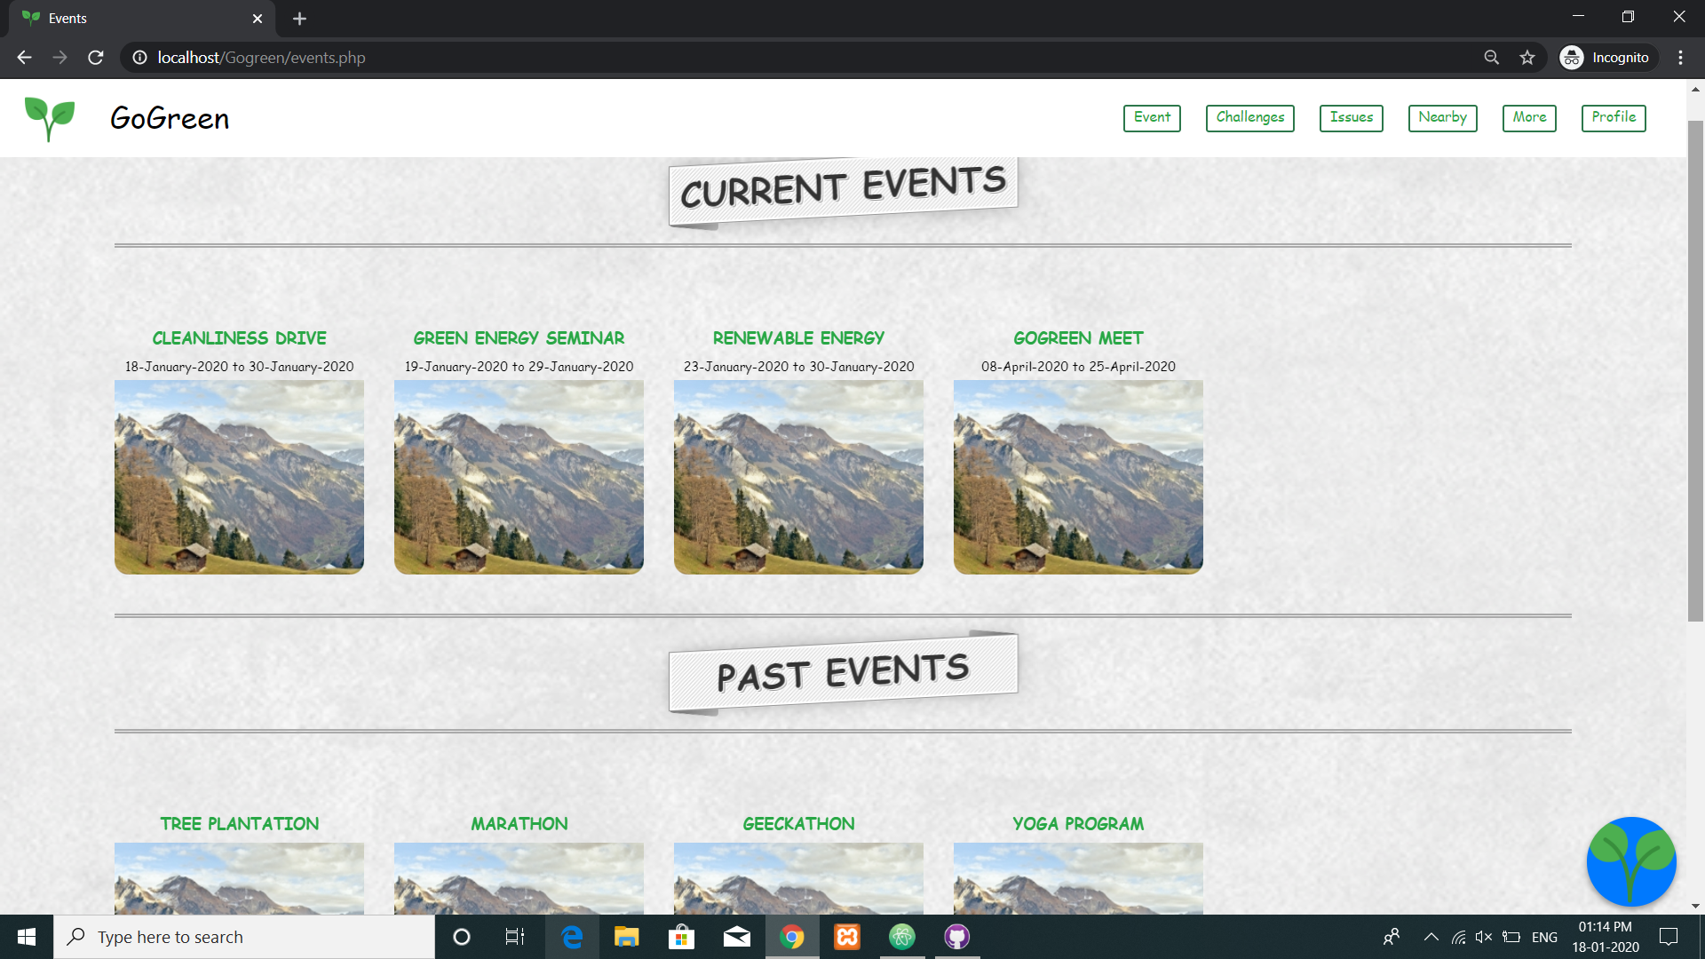
EVENTS

Slide 16
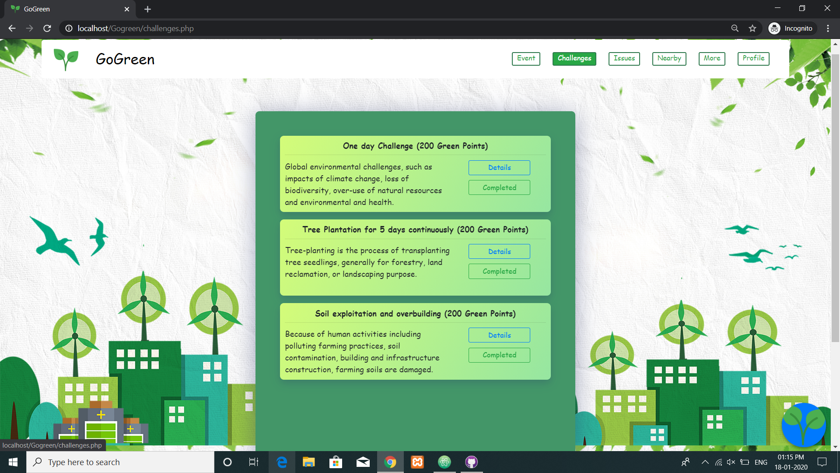
CHALLENGES

Slide 17
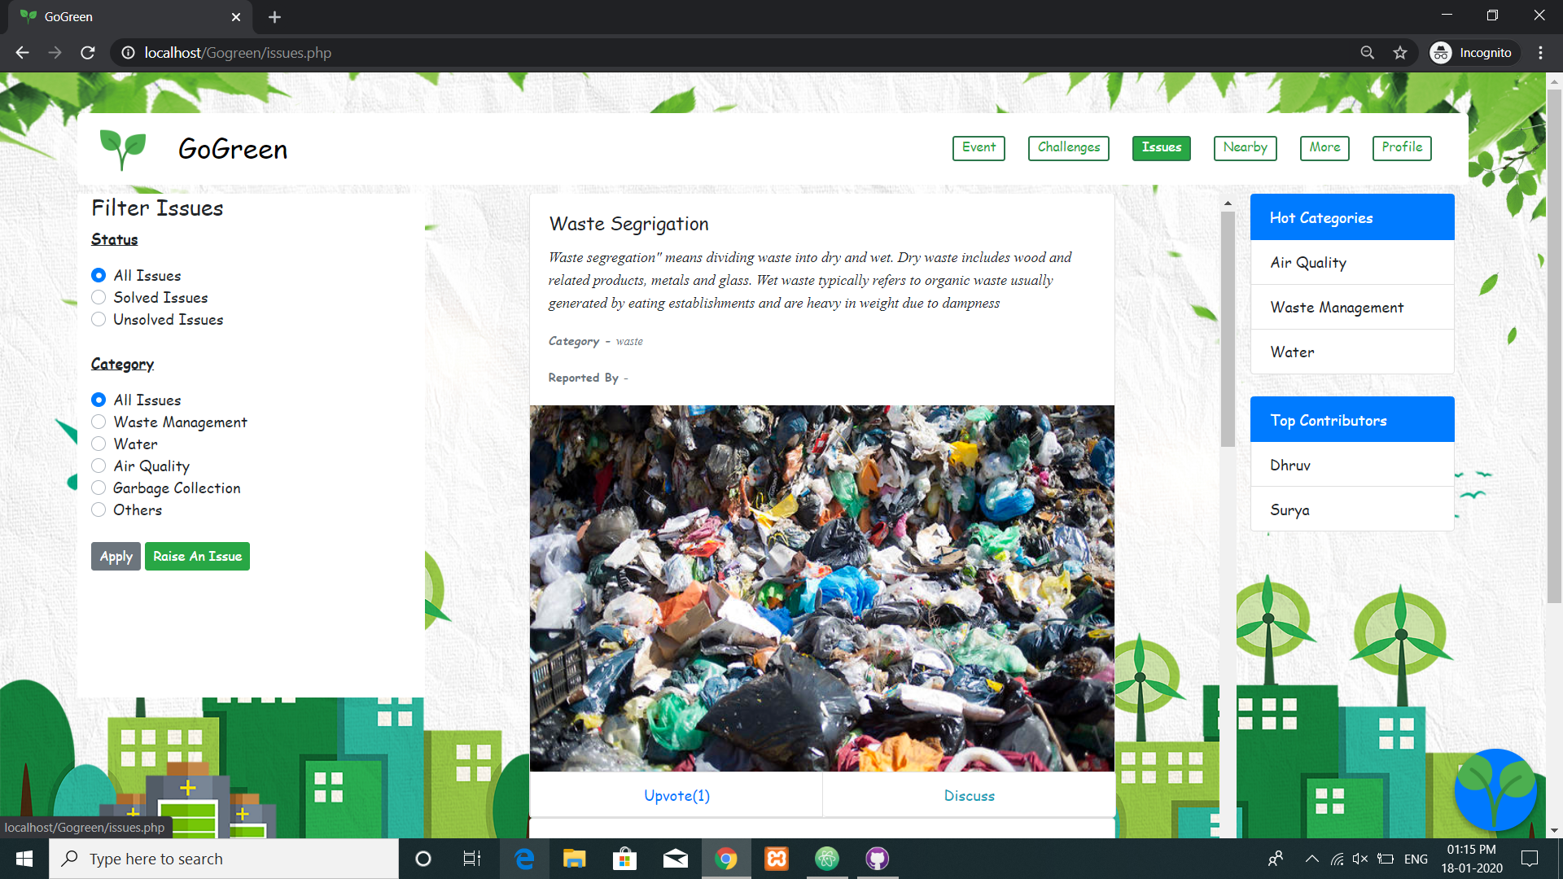
ISSUES

Slide 18
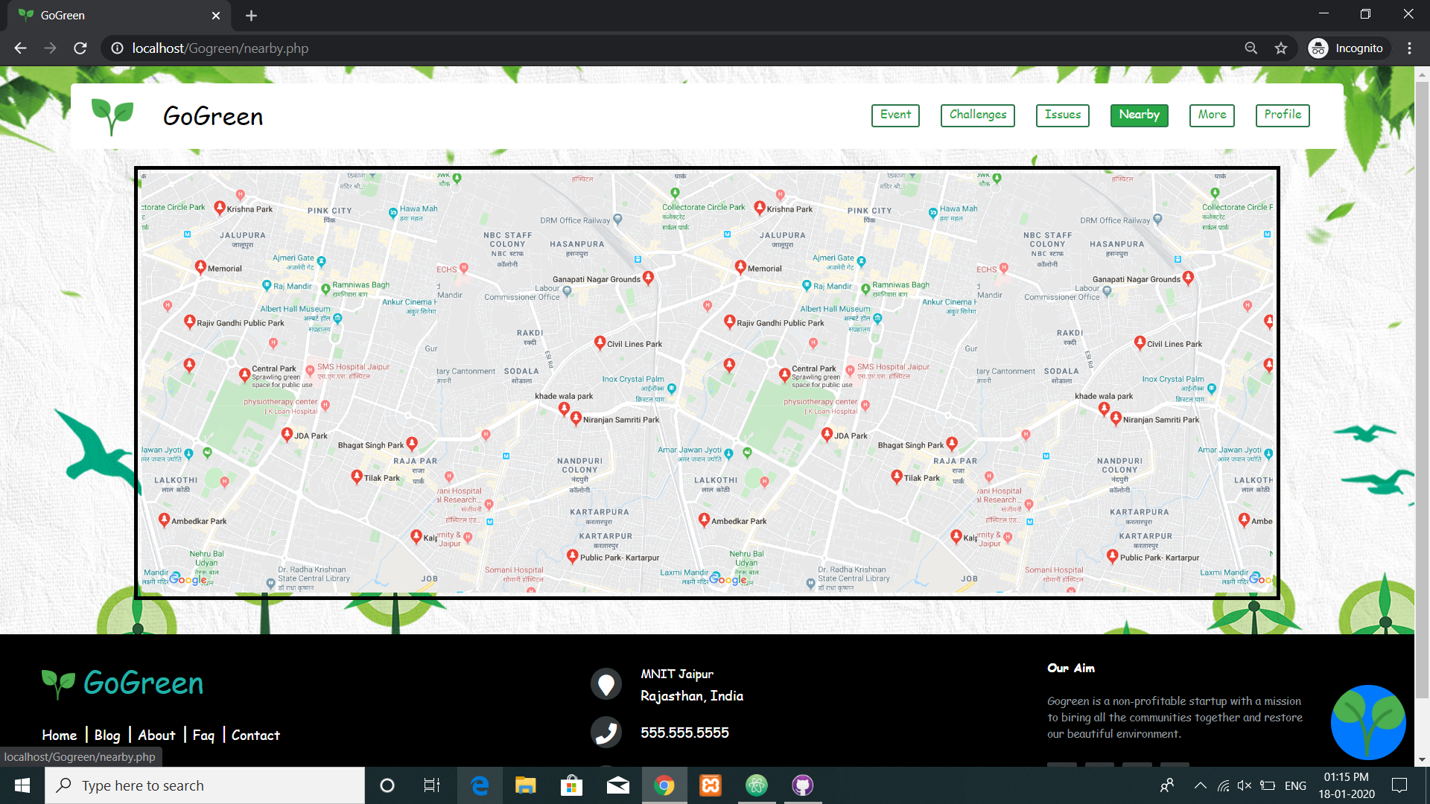
NEARBY

Slide 19
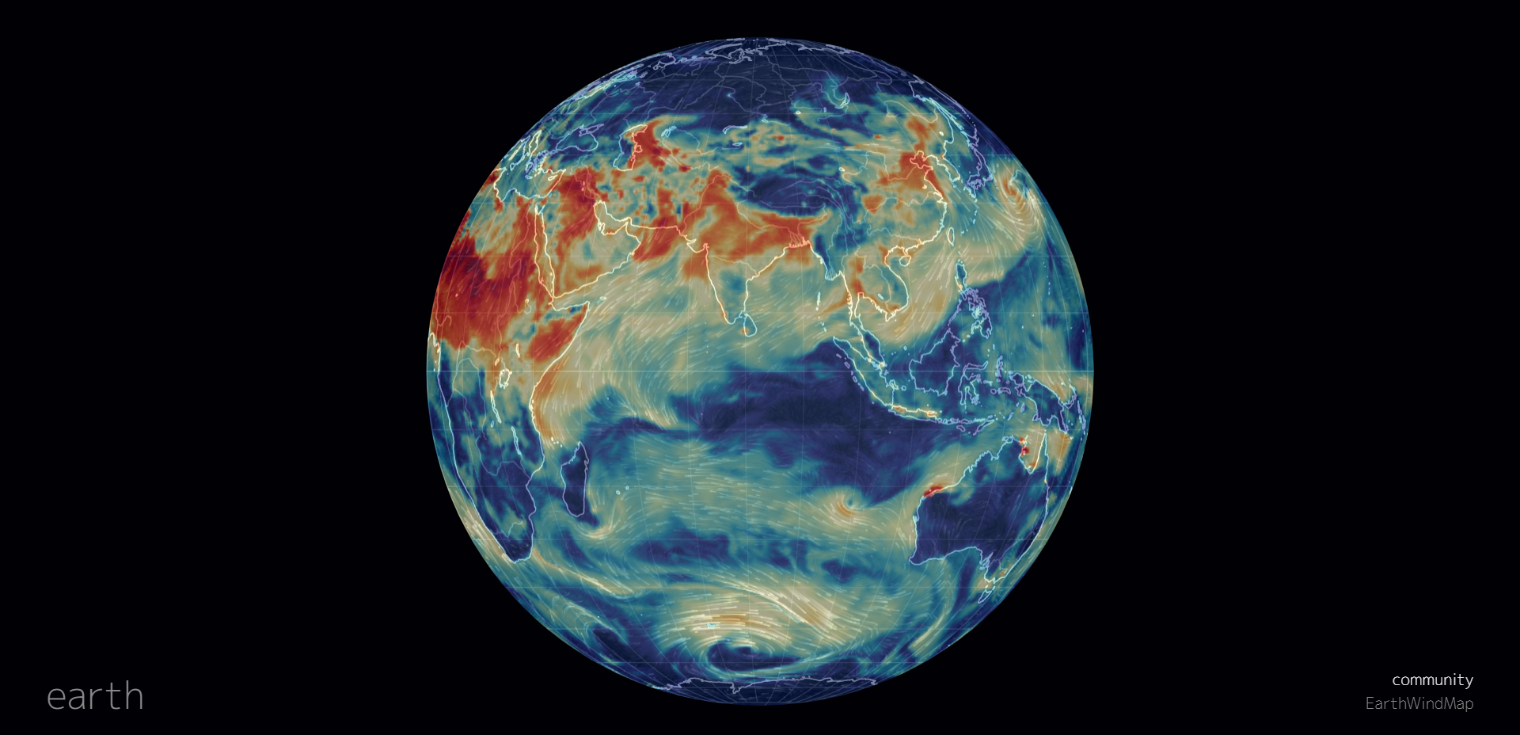
WEB-VIEW

Slide 20
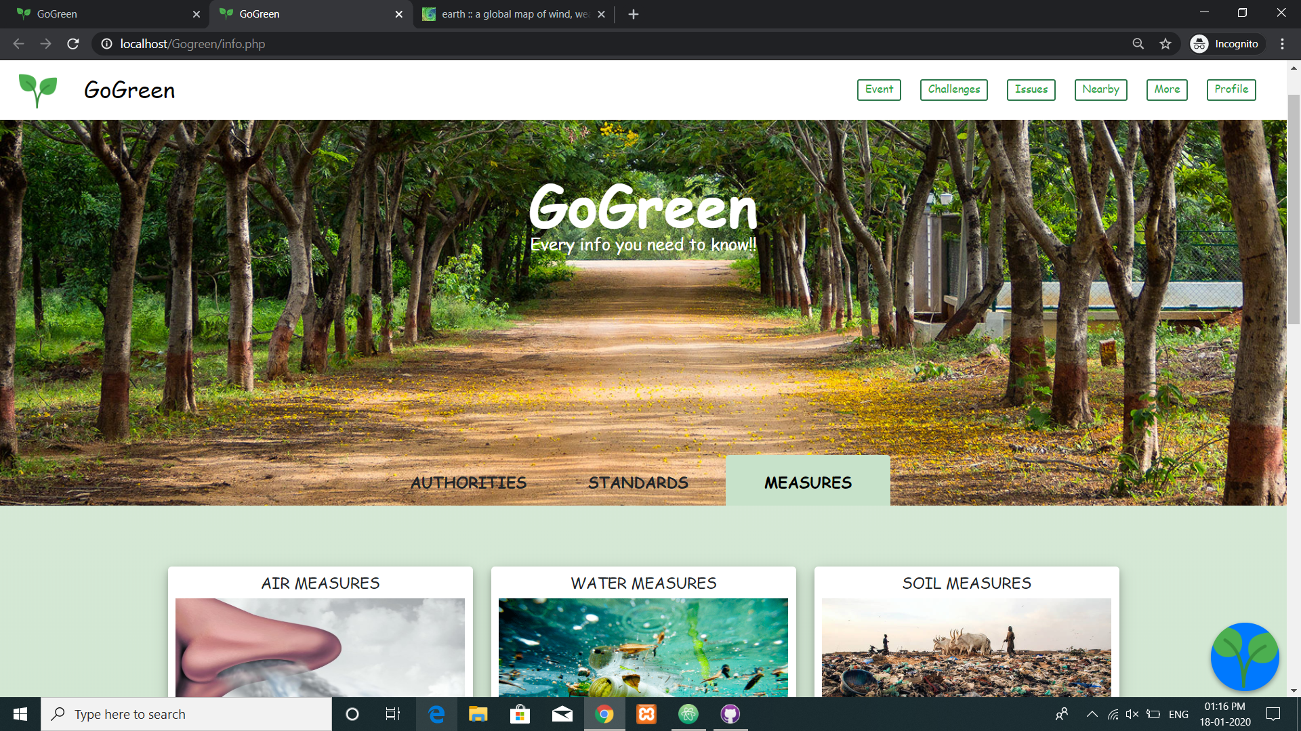
ENVIRONMENTOPEDIA

Slide 21
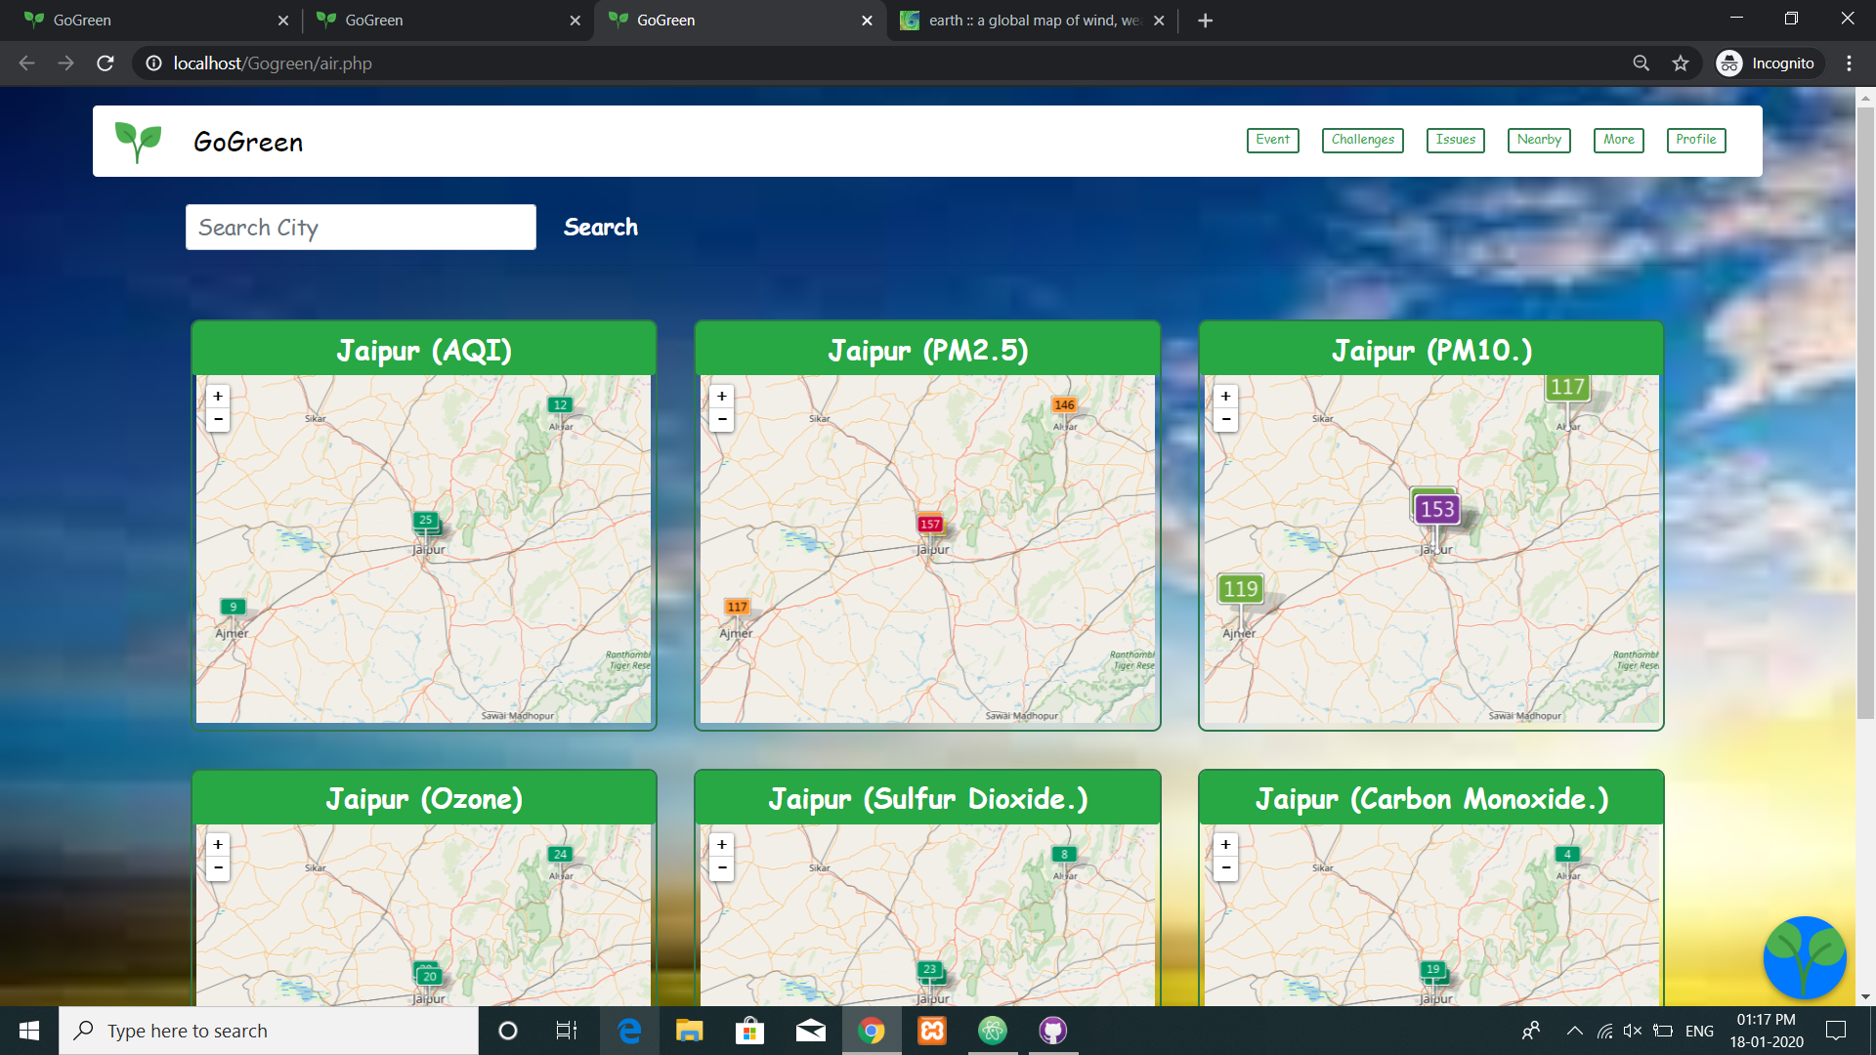
AIR QUALITY INDEX

Slide 22
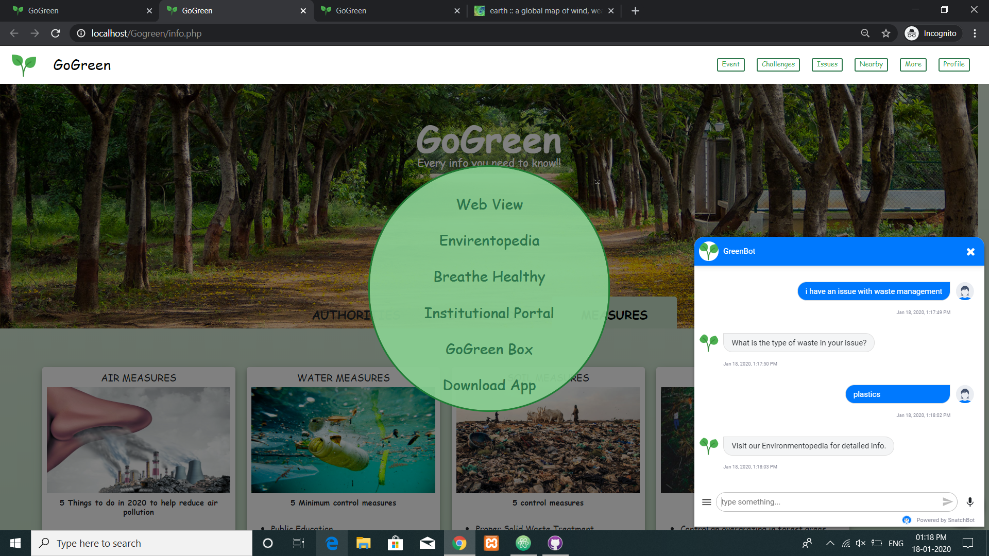
CHATBOT

Slide 23
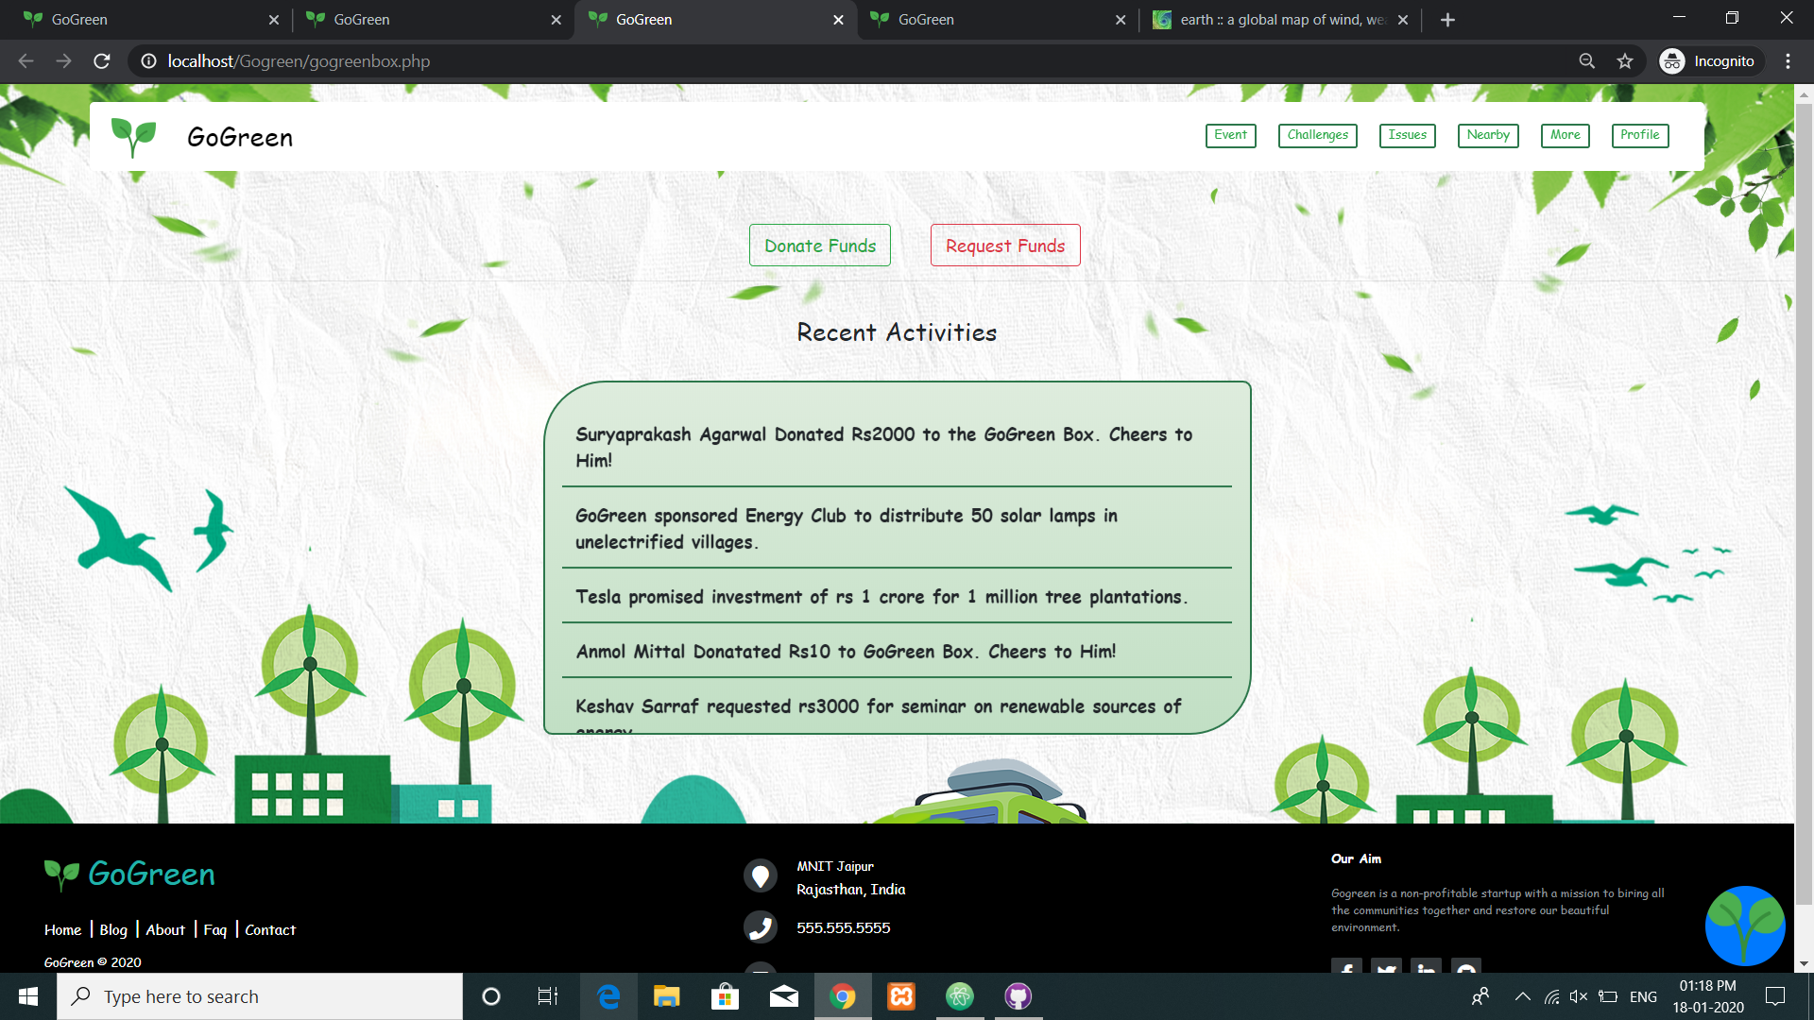
GOGREEN BOX

Slide 24
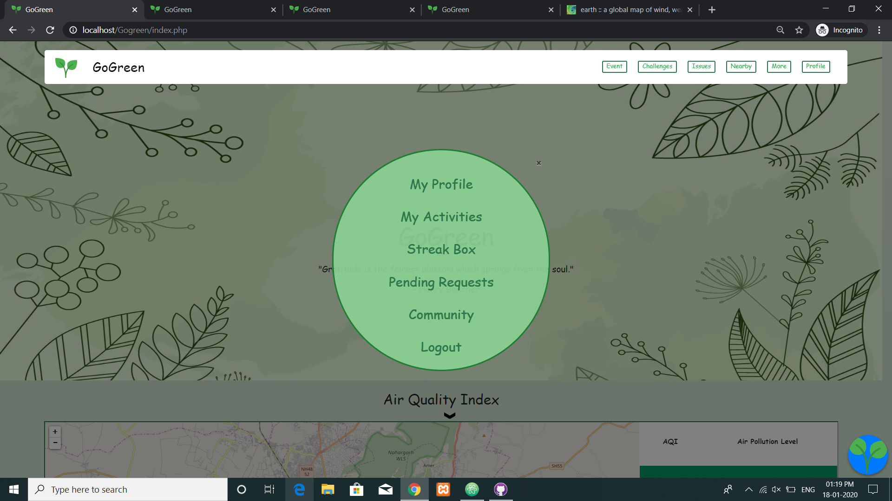
PROFILE

Slide 25
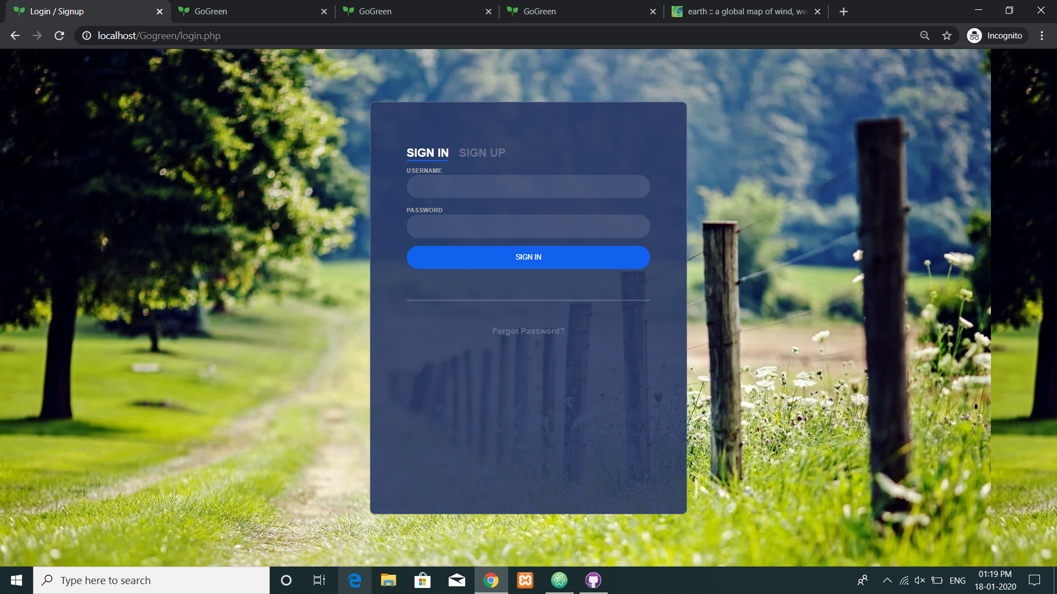
USER LOGIN

Slide 26
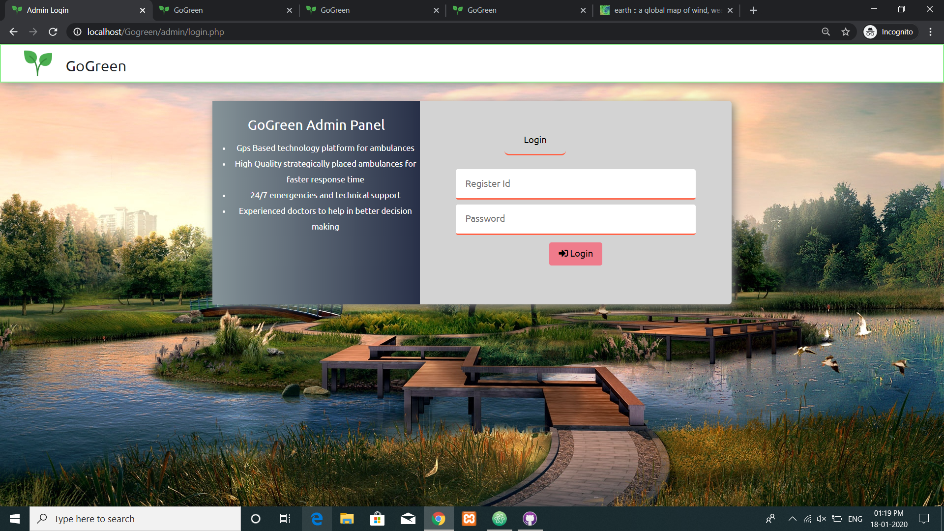
ADMIN LOGIN

Slide 27
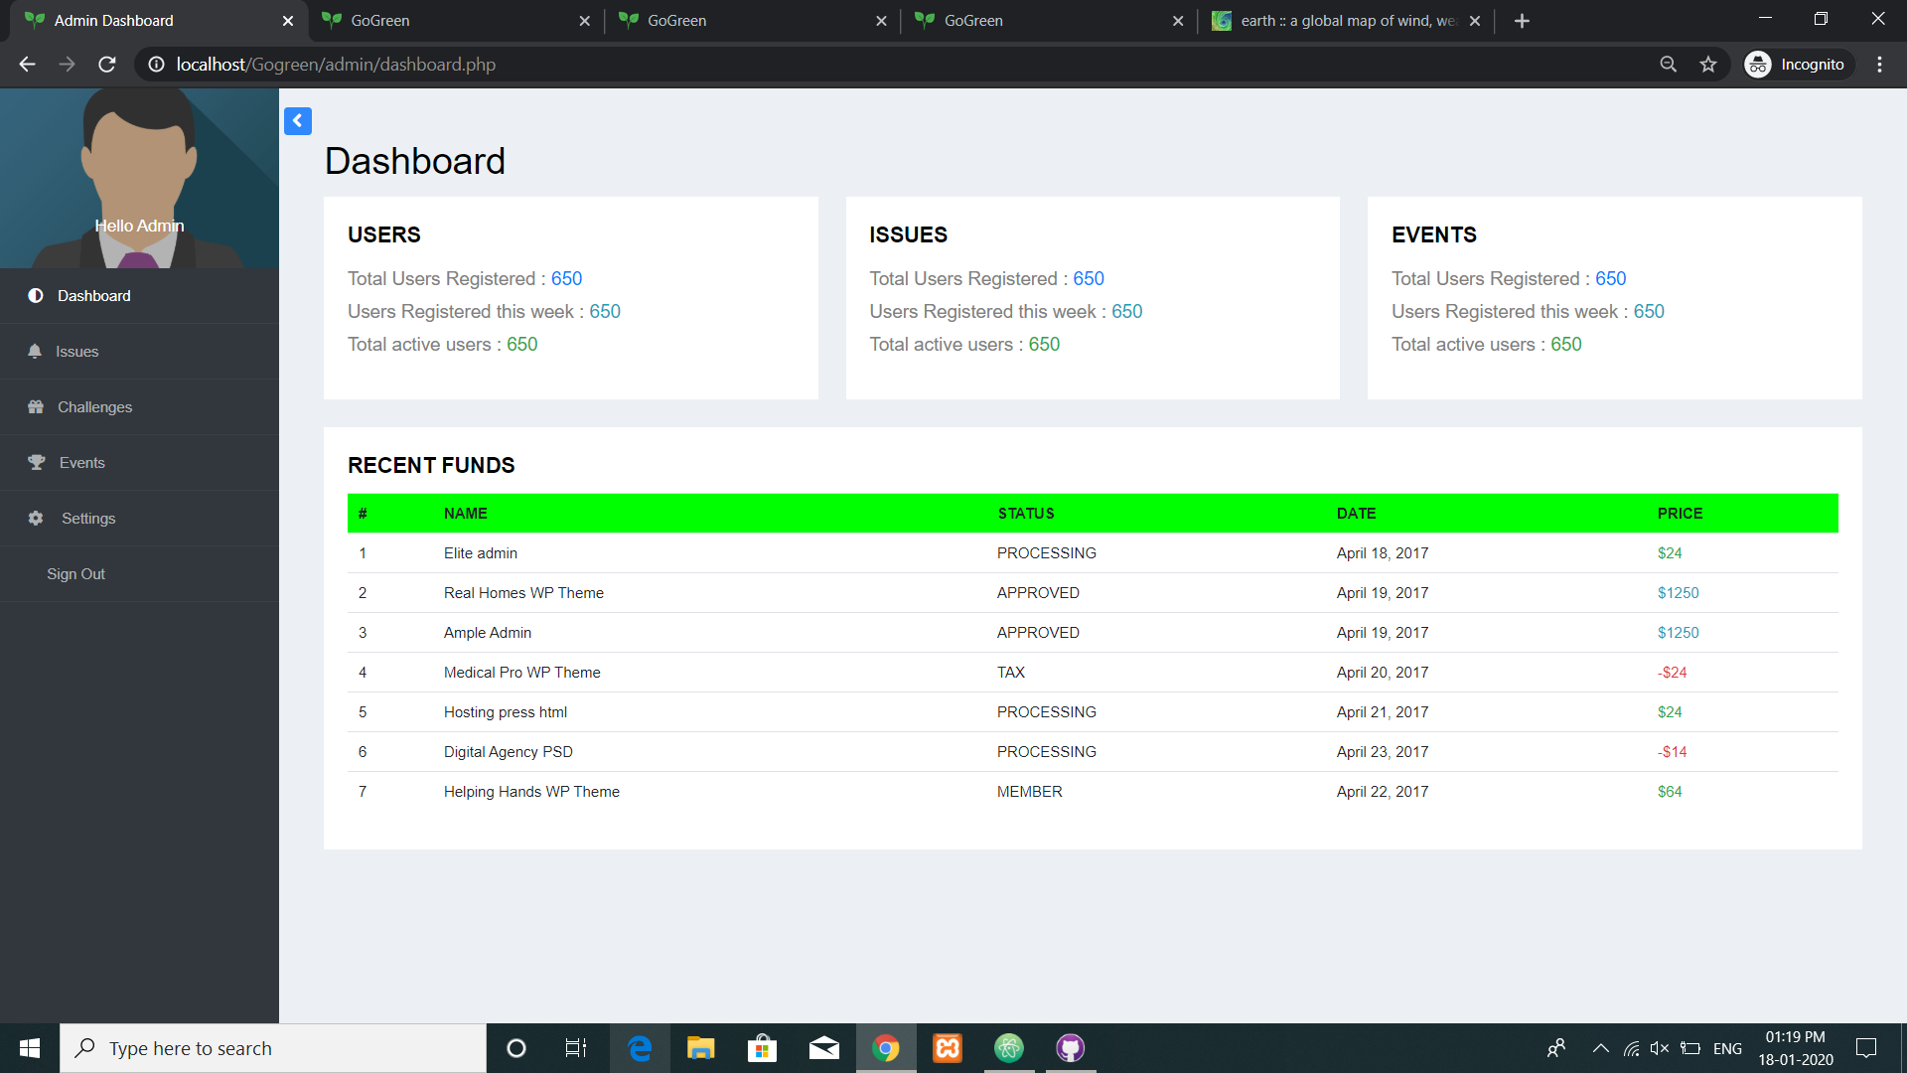
ADMIN PORTAL

Slide 28
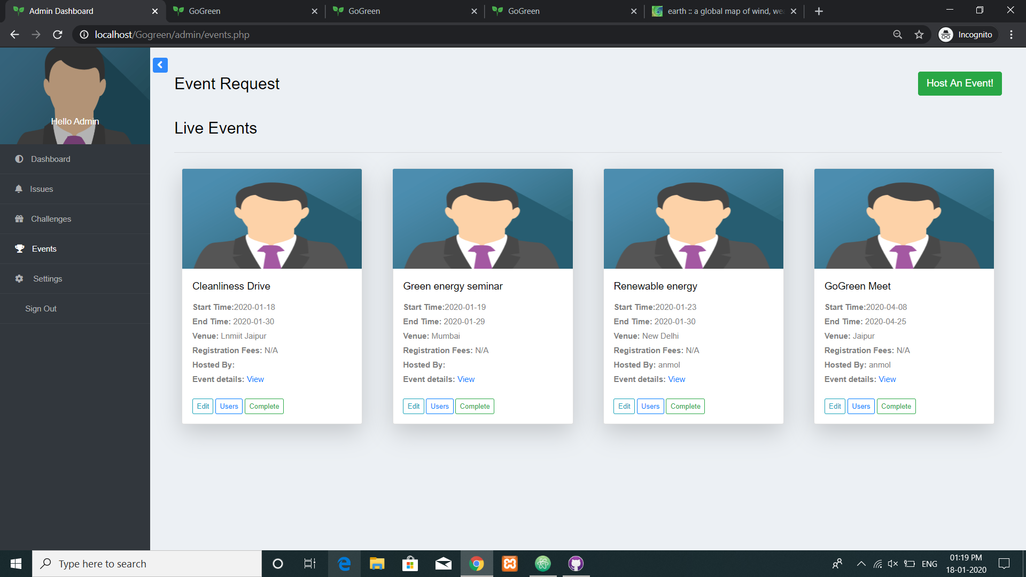
ADMIN(EVENT CONTROL)

Slide 29
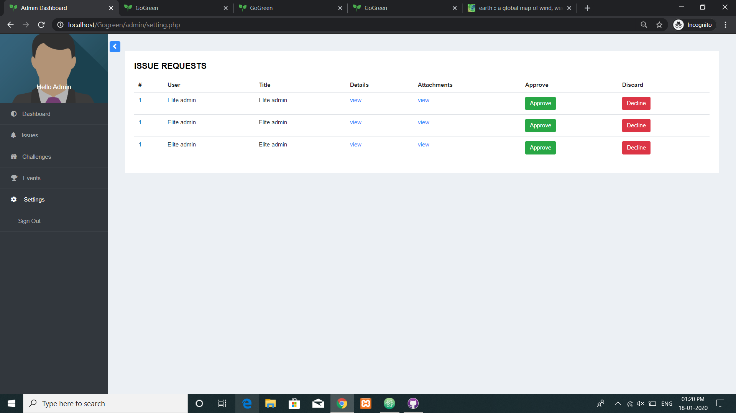
ADMIN(ISSUES)

Slide 30
Technology bucket
Frontend :-
Html
CSS
JavaScript
Bootstrap
jQuery
Backend :-
PHP
MySQL
Python
Java
Firebase API
Machine Learning:-
KERAS
Java SDK
Tensorflow Lite

Slide 31
Any Questions ???

Slide 32
Thank You..!

